Slide 1

Marketing the Ford Ka
Marketing Analytics 95-832, Homework 1
Group 2: Spriha Gupta; Jasmine Kaur; Daniel Lesser; Joseph Standerfer

Slide 2


Segmentation Strategies
Gender segmentation – Ford’s Marketing team
Pro: Women are more likely to buy small cars
Con: Unoriginal strategy; already being employed by the Peugeot 106
Attitudinal segmentation – Market Research agency
Pro: “Freedom Lovers” and “Attention Seekers” emerged from the cluster analysis of the psychographic tests.
Con: more expensive to target groups

Slide 3
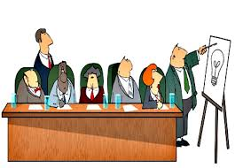

Segmentation Strategies
Demographic Segmentation – Senior management
Pro: Historical method of segmentation and using “observable” characteristics made it easier to identify and target an audience
The target groups would be “working singles”, “first-time buyers”, and “multi-car households”
Con: Market has changed
Current Car Segmentation – Dealership owners
Pro: Cheapest way to target individuals because mailing lists were already available
Con: Owners could be reluctant to buy non-French brands and may be looking for something else now

Slide 4
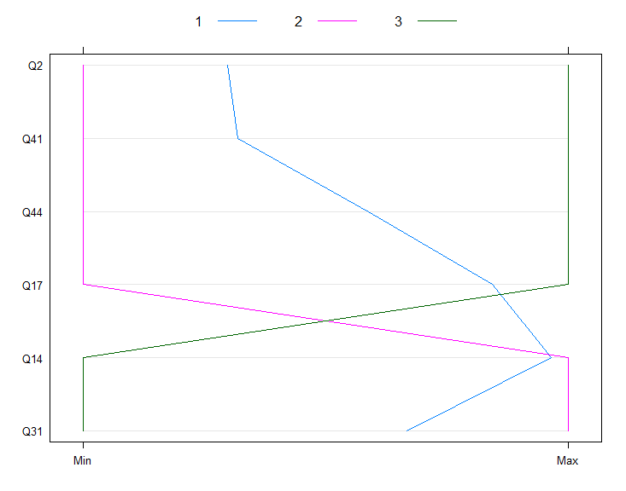
Visualizing our Data
Car preference ranking groups:
Top 3 (Buyers)
Bottom 3 (Non-buyers)
Middle 4 (Neutral)
Patterns:
The Buyers are looking for a comprehensive experience with their car. They value both car performance and fashion, with; slightly more weight given to performance.
The Non-buyers (middle 4) are mainly concerned with performance and comfort. They pace little to no value in fashion or making a statement.
Those who fell in the middle placed a much higher value on fashion and would like their vehicle to make statement. Also, they were not looking for comfort or the ability to take road trips.
Q2. I am fashion conscious.
Q14. The car I buy must be able to handle long motorway journeys.
Q17. I want a car that is nippy and zippy.
Q31. I want a comfortable car.
Q41. In today's world it is anti-social to drive big cars.
Q44. I want to buy a car that makes a statement about me.

Slide 5
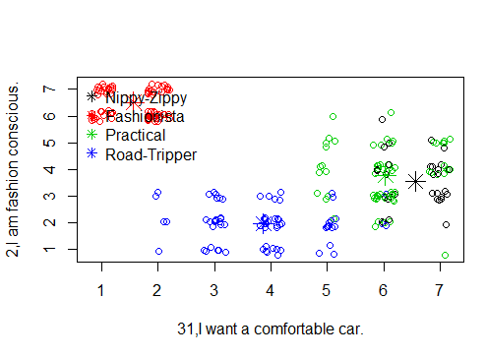
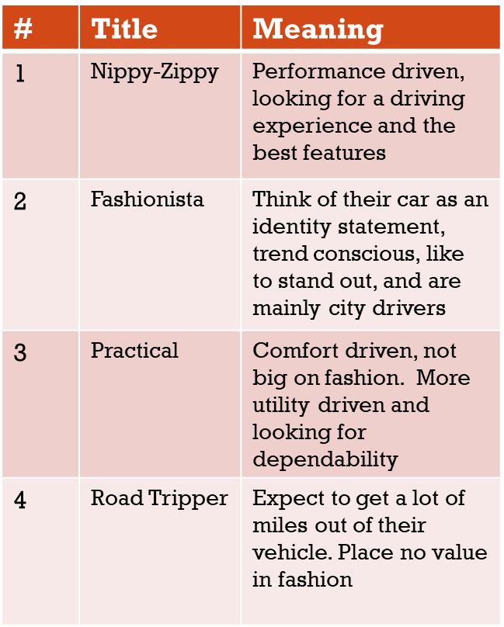
What do the clusters mean?
What are your clusters?
What do your clusters mean?

Slide 6
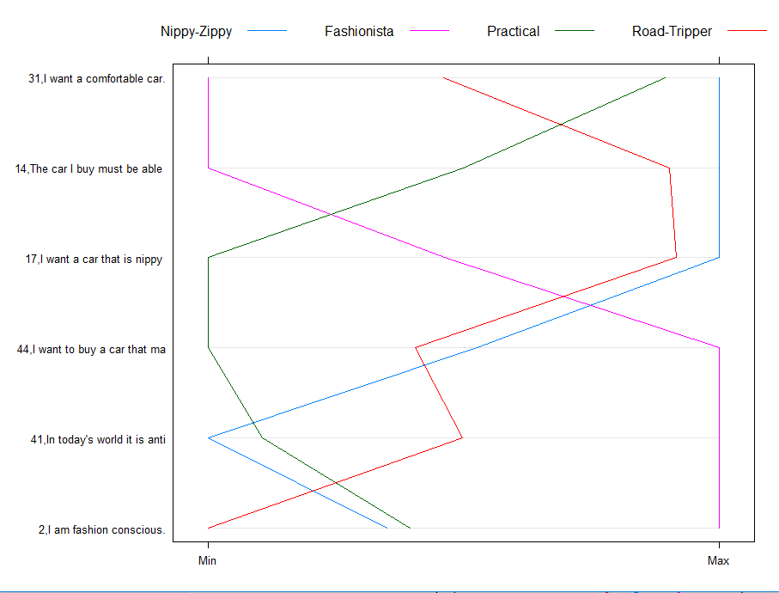
What do the clusters mean?
What are your clusters?
What do your clusters mean?

Slide 7
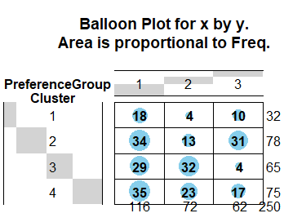
Recommendation of Clustering Solution
We recommend clustering on psychographic dimensions.
Cluster 2 (Fashionistas)
Greatest number of choosers and neutrals.
Aligns with target audience from the Renault Twingo.
Cluster 1 (Nippy-Zippy)
Natural buyers for the Ford Ka (56%).
Cluster is relatively small and should be a secondary focus.
Cluster is fundamentally different than Cluster 2.
Creative marketing required to reach both segments at the same time.

